Slide 1
QRHomework.org
Directions to Students
The quick response homework system is being developed to give you relevant practice on numerical concepts. This system is free to use and is still under construction so suggestions on improving they system will always be appreciated. Unlike systems you may have used in the past, QRhomework is really made for you to print out the problem and work it as you would a problem from a textbook. You can check you answer on your phone or computer. If you get stuck, you may try working the base-case problem. You are provided the answers to the basecase problem. Questions also come with reflections that your instructor may assign.

Slide 2
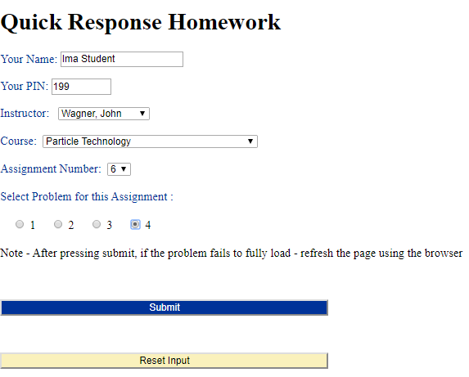
In your Browser Chrome is recommended) Type: QRHomework.org to get:
Fill this out – Your Instructor Should provide you with your PIN
Please Note this – if it the problem does not fully load is will have markup like ##mdot,num,20## in the statement

Slide 3
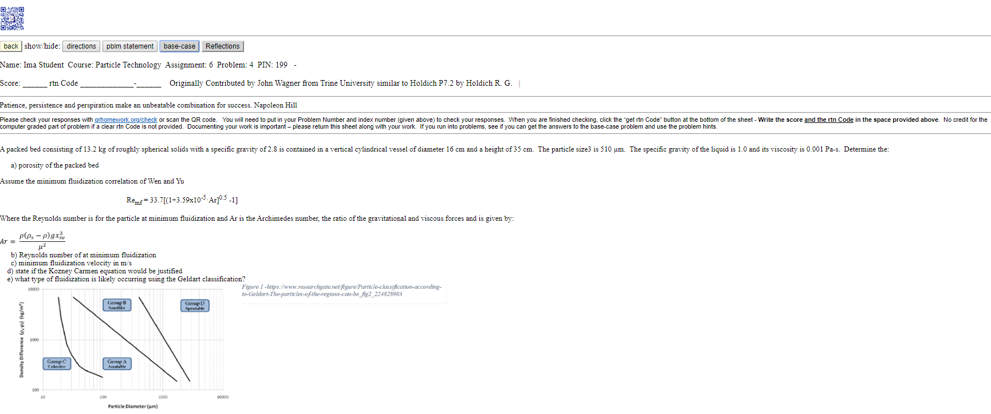
Each Student Receives a Different Version of the Same problem You can print this out with Ctrl P on most browsers
You will be given a rtn-Code when you are finished this is where you write it down on the problem printout

Slide 4
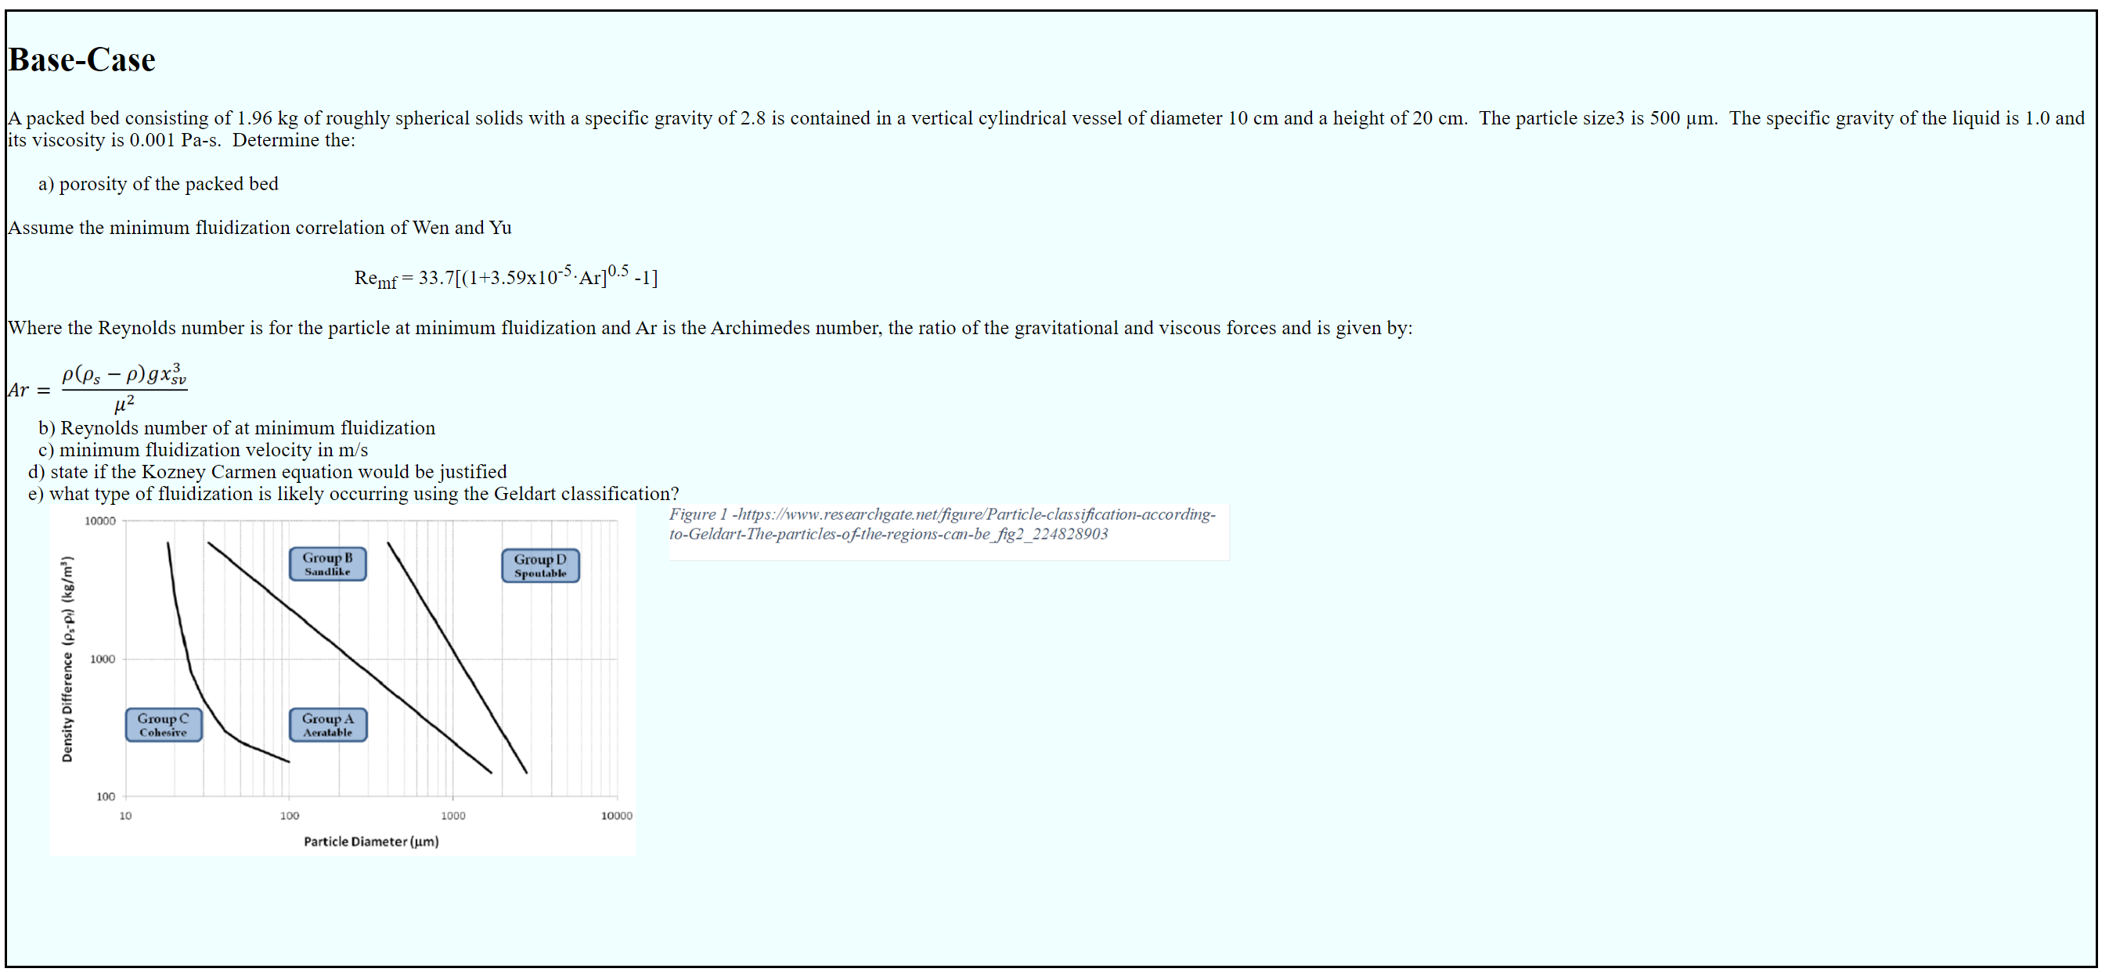
The Base Case is the Same for All Students (you can get the answers to the Base-Case Problem)

Slide 5
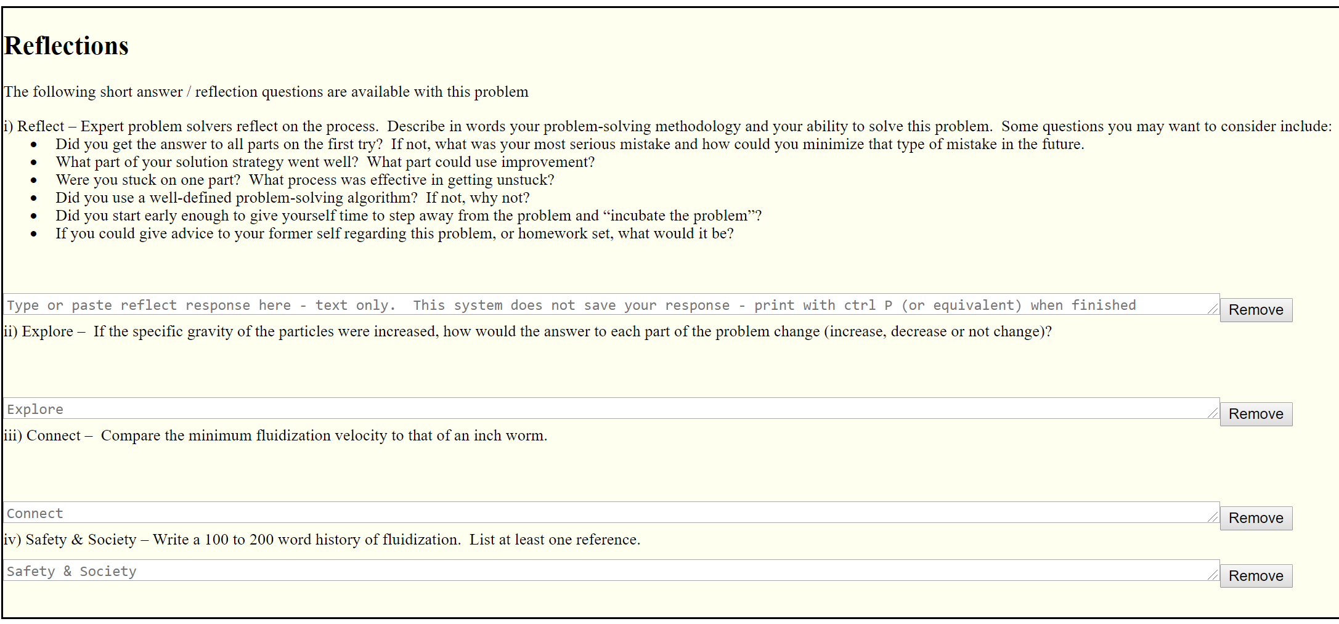
Some Reflections may be assigned by your instructor

Slide 6
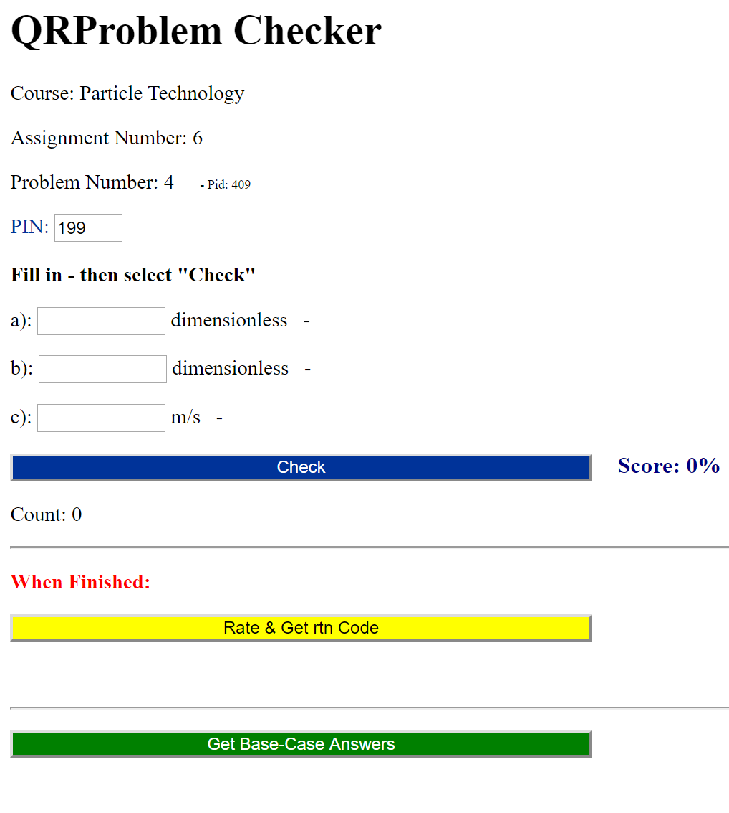
Check Your Answers
You can check each part of your answer as many times as you like without penalty – however the system will slow after to many guesses
Get answer to Base-Case Problem Here

